Slide 1

Pemrograman Web
Pemrograman Web
Jihadul Akbar
Pengenalan HTML

Slide 2

Cakupan Materi
Sejarah HTML
Tag-tag HTML
HTML5

Slide 3
<HTML>
Hypertext Markup Language

Slide 4
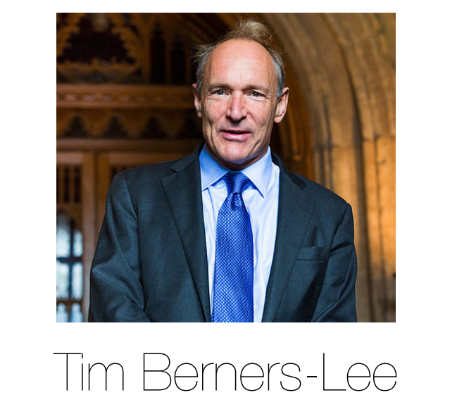

Slide 5
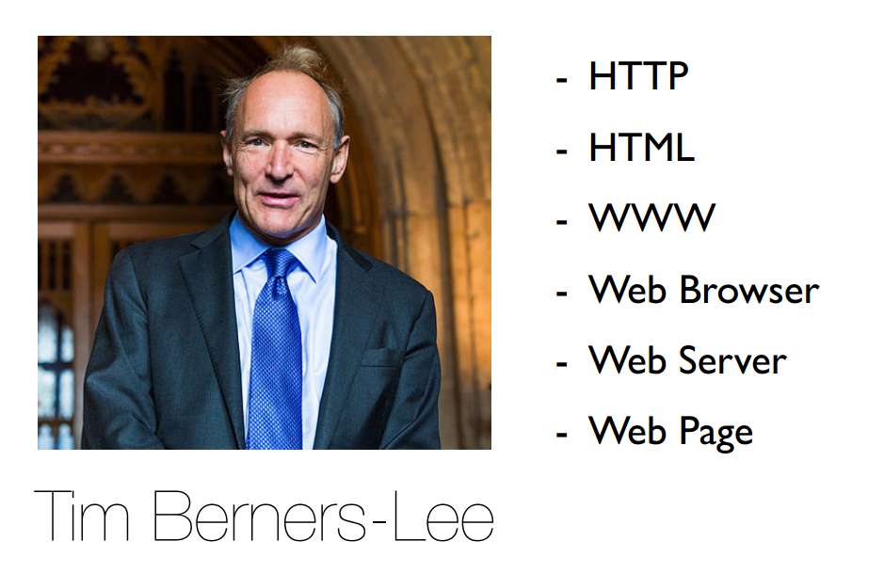

Slide 6


Slide 7
What is HTML?
HTML stands for Hyper Text Markup Language
HTML describes the structure of Web pages using markup
HTML elements are the building blocks of HTML pages
HTML elements are represented by tags
HTML tags label pieces of content such as "heading", "paragraph", "table", and so on
Browsers do not display the HTML tags, but use them to render the content of the page
https://www.w3schools.com/html/html_intro.asp

Slide 8
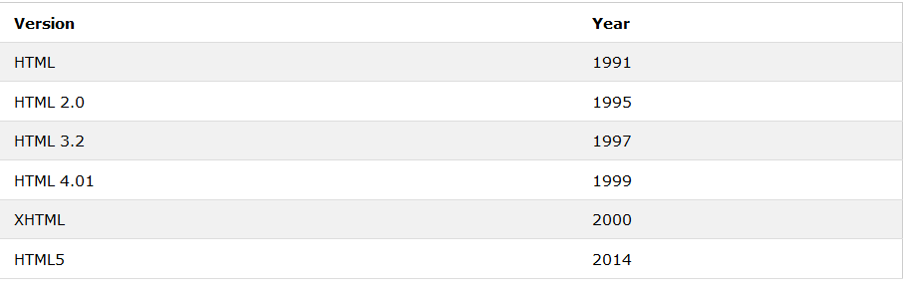
Version HTML?
https://www.w3schools.com/html/html_intro.asp

Slide 9
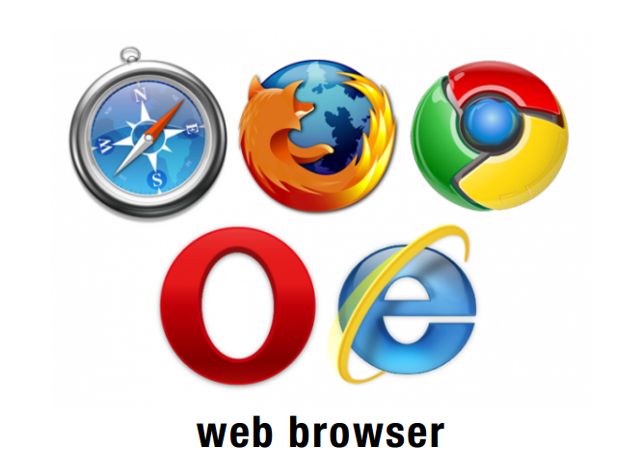

Slide 10
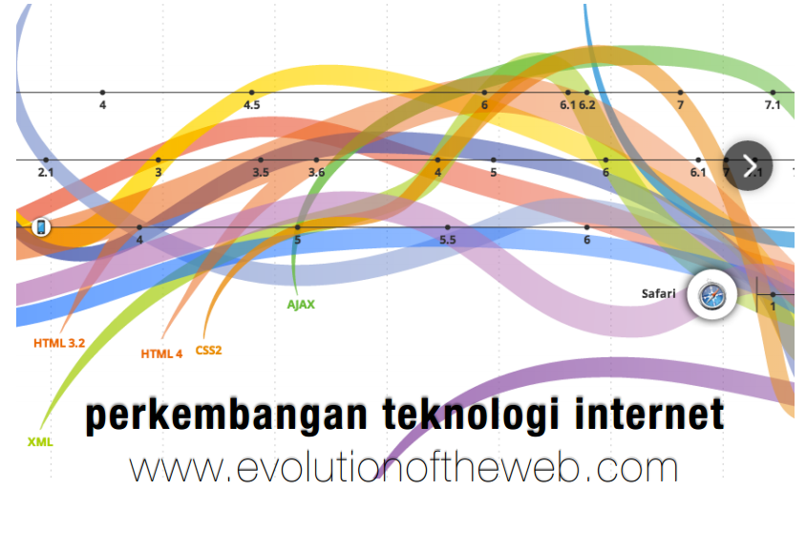

Slide 11
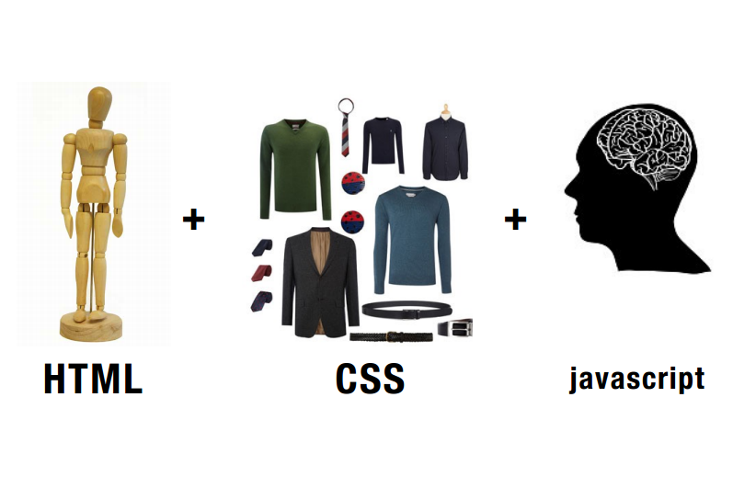

Slide 12
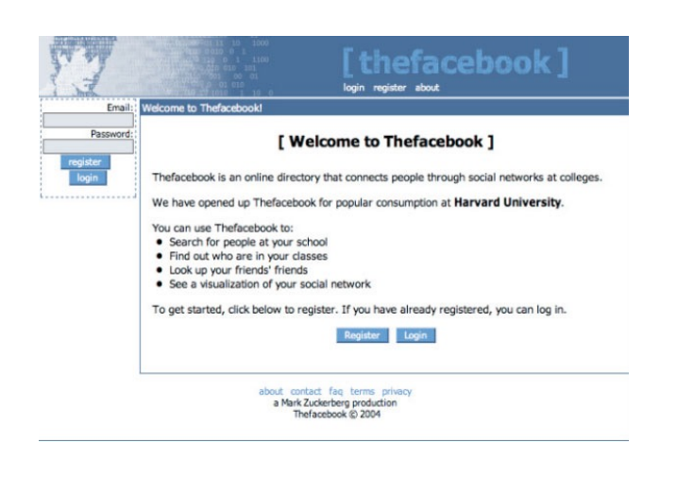

Slide 13
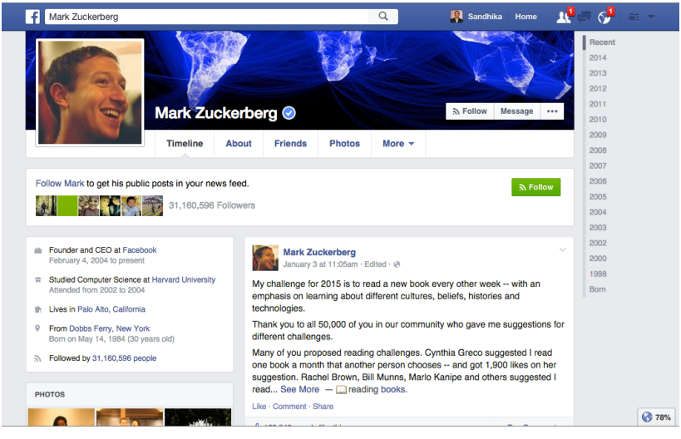

Slide 14
Let’s Code!

Slide 15

Sublime Text 3
https://www.sublimetext.com/

Slide 16
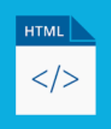
namafile.html

Slide 17
kerangaka
<HTML>

Slide 18
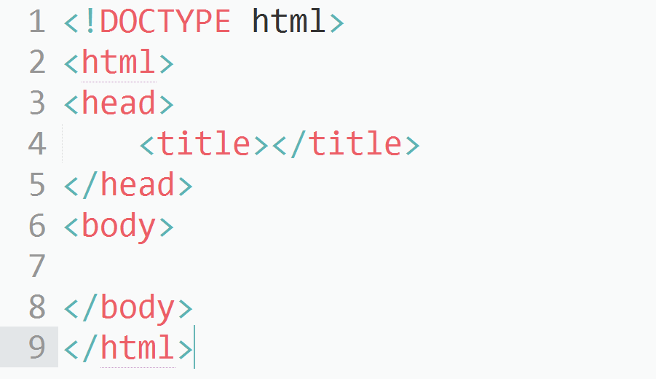

Slide 19
bagian
<head>

Slide 20
- Judul halaman
<title></title>
CSS
<style></style>
Javascript
<script></script>
Metadata
<meta></meta>

Slide 21
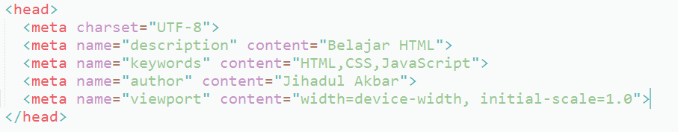
metadata

Slide 22
bagian
<body>

Slide 23
- teks
<h1>, <h2>, <h3>, <h4>, <h5>, <h6>, <p>, …
- pendukung teks
<br>, <hr>, <em>, <strong>, …
- gambar
<img>
- hyperlink
<a>
- list (bullets & numbering)
<ul>, <ol>, <li>, <dl>, <dt>, <dd>

Slide 24
- tabel
<table>, <thead>, <tbody>, …
- form
<form>, <input>, <select>, <button> …
- script
<script>
- object
<object>
- grouping
<div>, <span>

Slide 25
komentar
<!-- isi komentar-->

Slide 26
struktur
tag

Slide 27
<namatag atribut=“nilai”>

Slide 28
<body bgcolor=“lightblue”>

Slide 29
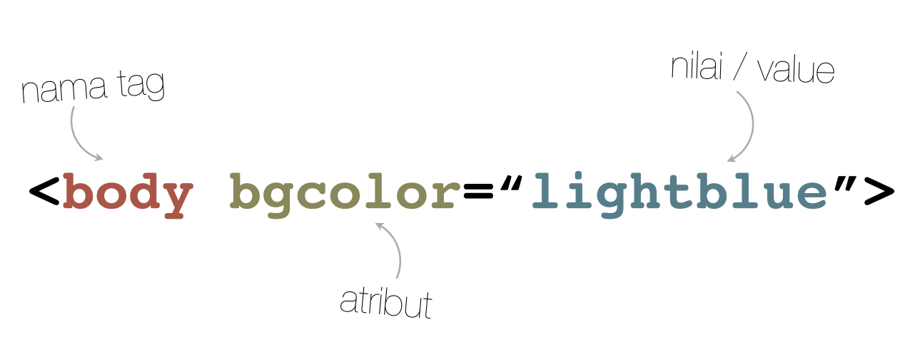

Slide 30
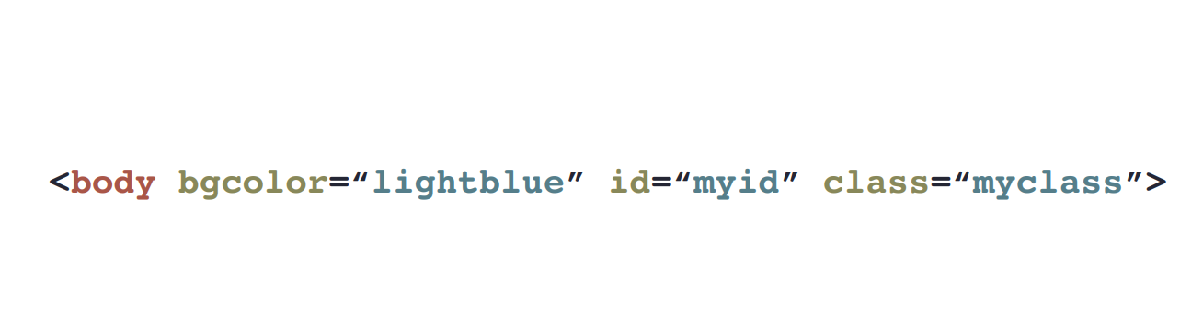

Slide 31


Slide 32
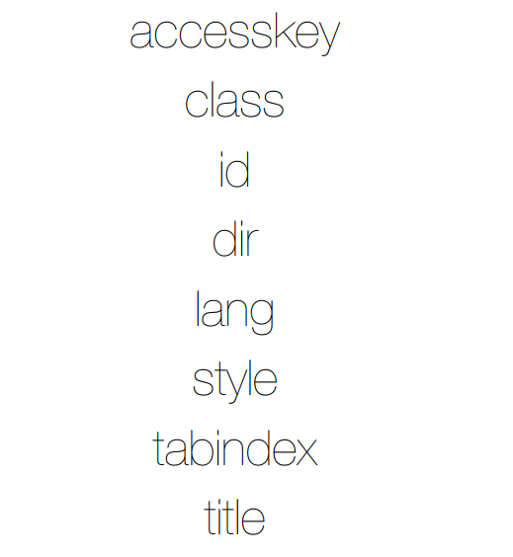

Slide 33


Slide 34

Sekian
Terimakasih

